Slide 1
Probability & Statistical Modelling
AQ077-3-2-PSMOD and Version VD1
Decision Making Techniques

Slide 2
Topic & Structure of The Lesson
Introduction
Decision making Under Uncertainty
Expected Value / Expected Opportunity Loss
Expected Value of perfect information
Decision Trees

Slide 3
Learning Outcomes
At the end of this topic, You should be able to
Understand how to calculate and use Expected Value
Know how to value Perfect and Imperfect information
Use various decision rules
Know what is meant by a Decision Tree
Be able to describe Decision Trees and Outcomes Nodes

Slide 4
Understand how to draw Decision Trees using the Forward Pass
Know that the outcome values are calculated using the backward pass
Be able to incorporate Bayes’ Theorem into a Decision Tree.

Slide 5
Key Terms You Must Be Able To Use
If you have mastered this topic, you should be able to use the following terms correctly in your assignments and exams:
State of Nature
Decision Alternatives
Payoff Table
Maximax criterion
Maximin criterion
Minimax regret criterion
Hurwicz criterion
Expected Value
Expected Opportunity Loss
Expected value of perfect Information
Decision Tree

Slide 6
Introduction
Decision making involves the following
steps:
Recognise and clearly define the problem
Collect the information needed to analyse possible alternatives
Choose and implement the most feasible alternative

Slide 7
Problem formulation
A decision problem is characterized by decision alternatives, states of nature, and resulting payoffs.
The decision alternatives are the different possible strategies the decision maker can employ.
The states of nature refer to future events, not under the control of the decision maker, which may occur. States of nature should be defined so that they are mutually exclusive and collectively exhaustive.

Slide 8
Decision Theory
a general approach to decision making when the outcomes associated with alternatives are often in doubt
List the feasible alternatives
List the events
Calculate the payoff
Estimate the likelihood of each event
Select a decision rule

Slide 9
When a decision has to be made, there will be a range of possible action
Each action will have a certain consequences or payoff

Slide 10
Decision Making Under Certainty
Manager knows which event will occur
pick the alternative with the best payoff
What is the best choice if future demand will be low?

Slide 11
Decision Making Under Uncertainty
Decision making without probability
(no probability of occurrence are assigned)
Decision making with probabilities
(probabilities can be assigned)

Slide 12
Decision Making Without Probabilities
Decision Criteria
Maximax criterion
Maximin criterion
Minimax regret criterion
Hurwicz criterion

Slide 13
Maximax Criterion
maximise the maximum profit
optimistic - looks at the best possible payoffs
ignores the possibility of a potential loss
N/B: maximax criterion deals with profit, if the payoff table consists of costs, then minimin criterion would be used ( i.e. minimise the minimum costs)

Slide 14
Quick Review Question
Decision making without probability
(no probability of occurrence are assigned)
Determine the maximax criterion for our investment.

Slide 15
Decision making without probability
(no probability of occurrence are assigned)
The maximax criterion for our investment is to purchase office building.

Slide 16
Maximin Criterion
looks at the worst possible payoffs
pessimistic and conservative
results in the maximum of the minimum profit
Its equivalent is minimax (i.e. minimise the maximum cost)

Slide 17
Decision making without probability
(no probability of occurrence are assigned)
Determine the maximin criterion for our investment.

Slide 18
Quick Review Question
Decision making without probability
(no probability of occurrence are assigned)
The maximin criterion for our investment is to purchase apartment building.

Slide 19
Minimax Regret Criterion
Regret (opportunity loss) is the difference between the payoff from the best decision and all other decision payoffs in those circumstances
In this criterion decision maker attempts to avoid regret by selecting the decision alternative that minimises the maximum regret

Slide 20
Decision making without probability
(no probability of occurrence are assigned)

Slide 21
Decision making without probability
(no probability of occurrence are assigned)
Regret Table

Slide 22
Decision making without probability
(no probability of occurrence are assigned)
Decision:
According to minimax regret criterion, the decision should be to purchase apartment building because this decision will result, at most, $50,000 in regret.

Slide 23
Hurwicz Criterion
a comprise between the maximax and maximin criteria
introduce α, the coefficient of optimism
0< α <1; It is a measure of the decision maker’s optimism
Multiplies the best payoff by α and the worst by (1 - α) , then select the decision which gives the maximum payoff

Slide 24
When α = 0 it is effectively the maximin criterion
when α = 1, it is the maximax criterion
α = 0.5 means the states of nature are equally likely to occur, it is known as Equally Likelihood Criterion

Slide 25
Determine the Hurwicz criterion decision of our investment example, let α = 0.4

Slide 26
α = 0.4, (1- α) =0.6

Slide 27
According to Hurwicz criterion (α =0.4), the maximum weighted value is $38,000. Thus, the decision would be to purchase the apartment building.

Slide 28
Determine the best decision using the equal likelihood criterion in our investment.

Slide 29
Determine the best decision using the equal likelihood criterion in our investment.

Slide 30
In applying the equal likelihood criterion, we are assuming 50% chance, that either state of nature will occur. Since $40,000 is the highest weighted value, the decision would be to purchase the apartment building.

Slide 31
Summary of criteria results:

Slide 32
Conclusion
Which criterion is appropriate is dependent on the risk personality and philosophy of the decision maker.

Slide 33
Example 1
Tutorial 2 Q2
A farmer in Georgia must decide which crop to plant next year
on his land: corn, peanuts, or soyabeans. The return from each crop will be determined by whether a new trade bill with Russia passes the Senate. The profit the farmer will realize from each crop given the two possible results on the trade bill as shown in the following payoff table. Determine the best crop to plant using the following decision criteria.
Maximax (d) Hurwicz ( α = 0.3)
Maximin (e) Equal likelihood
Minimax regret
 | Trade Bill
Crop | Pass ($) | Fail ($)
Corn | 35000 | $8000
Peanuts | 18000 | 12000
Soyabeans | 22000 | 20000

Slide 34
Decision Making with Probabilities
Expected Value Approach
If probabilistic information regarding the states of nature is available, one may use the expected value (EV) approach.
Expected value is computed by multiplying each decision outcome under each state of nature by the probability of its occurrence
The decision yielding the best expected return is chosen.

Slide 35
Payoff Tables
The consequence resulting from a specific combination of a decision alternative and a state of nature is a payoff.
A table showing payoffs for all combinations of decision alternatives and states of nature is a payoff table.
Payoffs can be expressed in terms of profit, cost, time, distance or any other appropriate measure.

Slide 36

Quick Review Question
Payoff Table for the real estate investments
Calculate the expected value of each choice and make the best decision.

Slide 37
Expected Opportunity Loss
Is the expected value of the regret for each decision.
Regret is the difference between the payoff from the best decision and all other decision payoffs.
Computed by multiplying each decision outcome (probability) by the regret i.e. opportunity loss

Slide 38
Payoff Table for the real estate investments
Calculate the expected opportunity loss (EOL) that would be experienced by the decision maker ?

Slide 39

An investor must decide among an apartment building, an office building and a warehouse using expected opportunity loss.
The regret values for each decision outcome were shown below with the probabilities of occurrence for each state of nature.

Slide 40
The expected opportunity loss for each decision is computed as follows:
EOL (apartment) = $50000(0.6) + 0(0.4) = $30000
EOL (Office) = $0(0.6) + 70000(0.4) = $28000
EOL (Warehouse) = $70000(0.6) + 20000(0.4) = $50000
The best decision results from minimizing the expected regret or opportunity loss. Since $28000 is the minimum expected regret, the decision is to purchase the office building (This decision will result, at most, $28,000 in regret)

Slide 41
Expected value of Perfect information(EVPI)
It is the maximum amount a decision maker would pay for addition information
Equals to the expected value given perfect information minus the expected value without perfect information.

Slide 42
Payoff table with Decisions, given perfect information is as below:
Determine the expected value of perfect information.

Slide 43
Expected value given perfect information
= $100,000 (0.6) + $30,000(0.4) = $72,000
Expected value without perfect information
= $100000 (0.6) – $40000(0.4) =$44000
EVPI = $72000 - $44000 = $28000
(This is the maximum amount that the investor would pay to purchase perfect information from other source, such as an economic forecaster)
(lowest EOL)

Slide 44
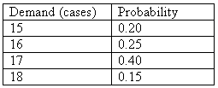
Example 2
The Loebuck Grocery must decide how many cases of milk to stock each week in order to meet demand. The probability distribution of demand during a week is shown in the table below:

Slide 45
Each case costs the grocer $10 and sells for $12. Unsold cases are sold to a local farmer (who mixes the milk with feed for livestock) for $2 per case. If there is a shortage, the grocer considers the cost of customer ill will and lost profit to be $4 per case. The grocer must decide how many cases of milk to order each week.
Construct the payoff table.
Compute the expected value of each alternative amount of milk that could be stocked, and select the best decision.

Slide 46
Decision Trees
A decision tree is a chronological representation of the decision problem. It is a graphical device that forces the decision-maker to examine all possible outcomes, including unfavorable ones.
makes easier the computation of the expected values
easy to understand the process of making decision

Slide 47
Each decision tree has two types of nodes; round nodes correspond to the states of nature while square nodes correspond to the decision alternatives.
The branches leaving each round node represent the different states of nature while the branches leaving each square node represent the different decision alternatives.

Slide 48
At the end of each limb of a tree are the payoffs attained from the series of branches making up that limb.

Slide 49
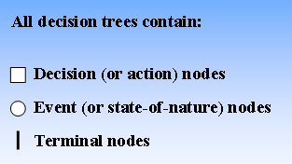
How to draw a decision Tree ?

Slide 50
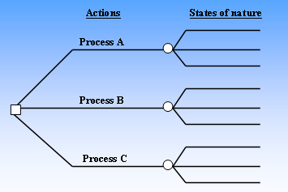

Slide 51
Start a decision tree with a decision that needs to be made which is represented by a small square.
From this square draw out lines towards the right for each possible solution, and write that solution along the line.
Keep this lines as far apart as possible so that you can expand on your thoughts.

Slide 52
At the end of each solution line, consider the results:
If the result of taking that decision is uncertain, draw a circle.
If the result is another decision that needs to be made, draw another square.
Write the decision or factor to be considered above the square or circle.
If you have completed the solution at the end of the line, just leave it blank.

Slide 53
Starting from the new decision squares on your diagram, draw out lines representing the options that could be taken.
From the circles draw out lines representing possible outcomes.
Again mark a brief note on the line saying what it means.

Slide 54
Keep on doing this until you have drawn down as many of the possible outcomes and decisions as you can see leading on from your original decision.
Review your tree diagram. Challenge each square and circle to see if there are any solutions or outcomes you have not considered. If there are, draw them in.

Slide 55
If necessary, redraft your tree if parts of it are too congested or untidy.

Slide 56
Evaluate Your decision Tree
Start by assigning a cash or numeric value to each possible outcome – how much you think it is worth.
Next look at each circle and estimate the probability of each outcome. (The total should be 100% or 1)

Slide 57
Calculating Tree Value
Start on the right hand side of the decision tree, and work back towards the left.
Record the result after completing the calculation on a node.
All the calculations that lead to the result can be ignored – effectively that branch of the tree can be discarded. (Pruning the tree)

Slide 58
Calculating the value of uncertain outcome nodes
Multiply the value of the outcomes by their probability, and noting the result.
The total value of that node of the tree is gained by adding the results together.

Slide 59
Calculating the value of decision nodes
Calculate the benefit of each decision (subtract the cost from the value of that outcome that you have already calculated)
Select the decision which has the largest benefit, and take that as the decision made

Slide 60
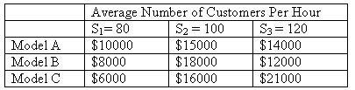
Quick Review Question
Example:
Burger Prince Restaurant is contemplating opening a new restaurant on Main Street. It has three different models, each with a different seating capacity. Burger Prince estimates that the average number of customers per hour will be 80, 100, or 120. The payoff table for the three models is as follows:

Slide 61
Calculate the expected value for each decision. The decision tree on the next slide can assist in this calculation. Here d1, d2, d3 represent the decision alternatives of models A, B, C, and s1, s2, s3 represent the states of nature of 80, 100, and 120.

Slide 62
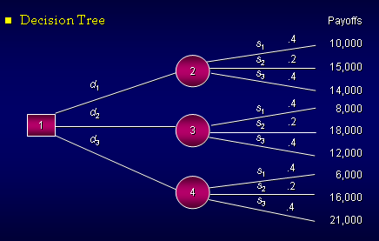

Slide 63
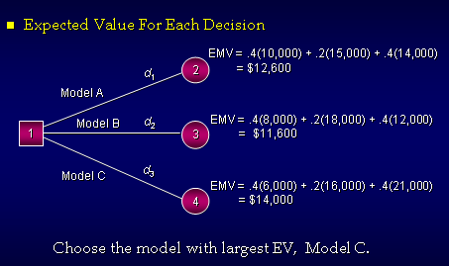

Slide 64
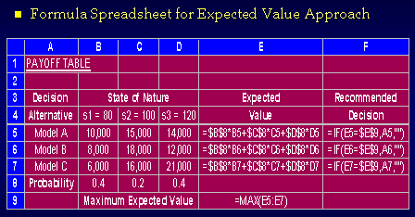

Slide 65
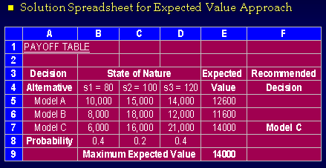

Slide 66
Example 3
The financial success of the Downhill Ski Resort in the Blue Ridge Mountains is dependent on the amount of snowfall during the winter months. If the snowfall averages more than 40 inches, the resort will be successful; if the snowfall is between 20 and 40 inches, the resort will receive a moderate financial return; and if snowfall averages less than 20 inches, the resort will suffer a financial loss. The financial return and probability given each level of snowfall follows.
Snowfall Level (in) Prob Financial Return ($)
>40, 0.4 120,000
20‑40, 0.2 40,000
<20, 0.4 - 40,000
A large hotel chain has offered to lease the resort for the winter for $40,000. Draw a decision tree and use it to determine if the resort should operate or lease. Explain your answer.

Slide 67
Summary of Main Teaching Points
Elements common to decision theory problems:
An objective the decision maker is trying to reach.
Several courses of action
A calculable measure of the benefit or worth of the various alternatives
Events beyond the control of the decision maker
Uncertainty concerning which outcome or state of nature will actually happen.

Slide 68
Decision trees provide an effective method of decision making because they:
Clearly lay out the problem so that all choices can be viewed, discussed and challenged
Provides a framework to quantify of the values of outcomes and the probabilities of achieving them
Help us to make the best decisions on the basis of our existing information and best guesses.

Slide 69
Question and Answer Session
Q & A

Slide 70
What we will cover next
END

